Slide 1
Deep Learning
5. Convolutional Networks
andrei.nicolicioiu@gmail.com

Slide 2
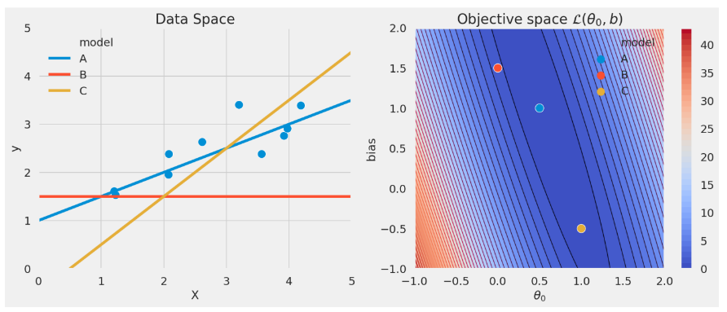
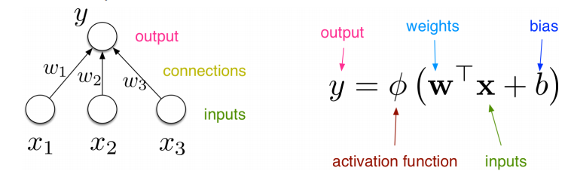
Recap

Slide 3
Recap
Linear models
Fow fitting a line on the set of points, how many parameters should we use?
Is the linear model appropriate?
What does the right column represent?
How can we write it as a neural network?

Slide 4
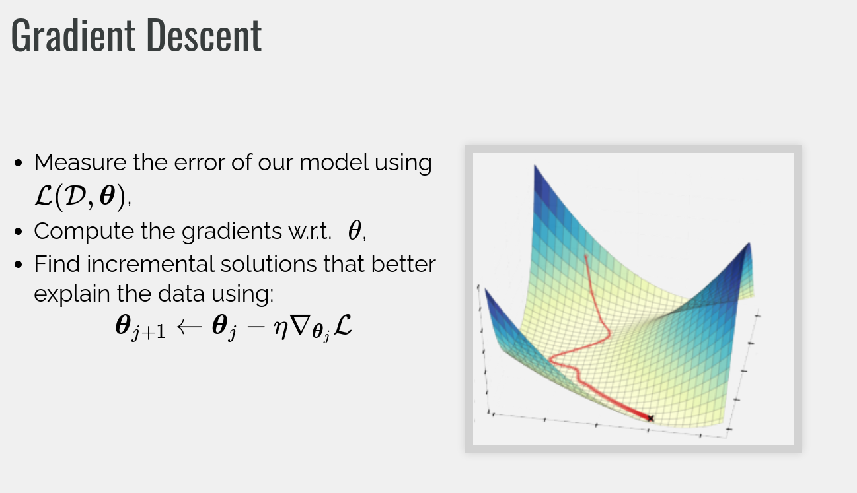

Slide 5
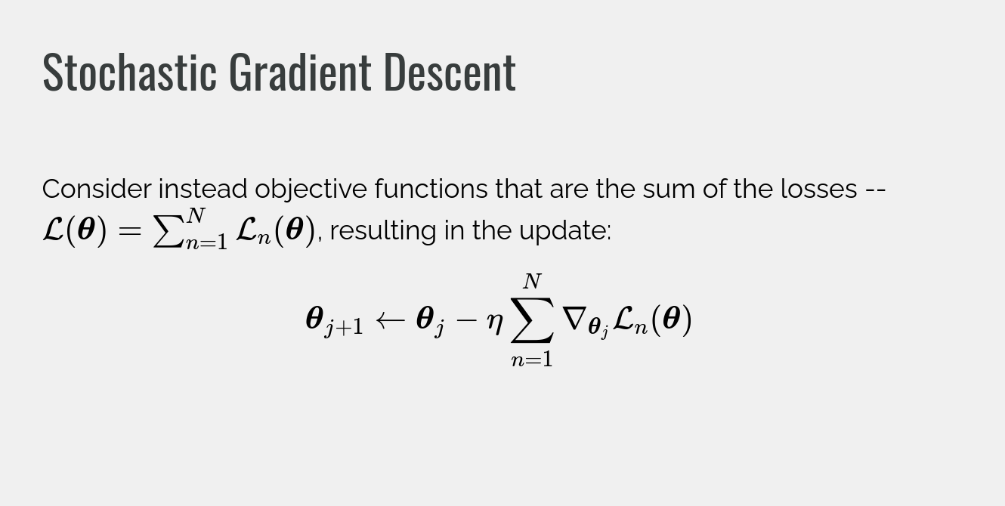

Slide 6
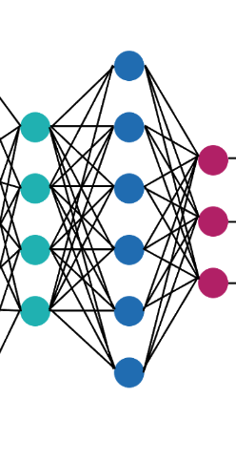
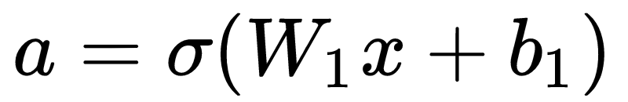
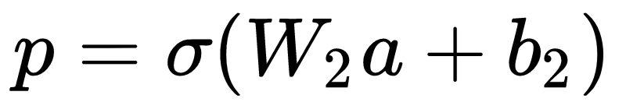
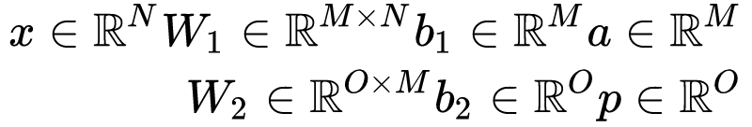
Recap: Fully connected networks
weights
activations
predictions
input

Slide 7
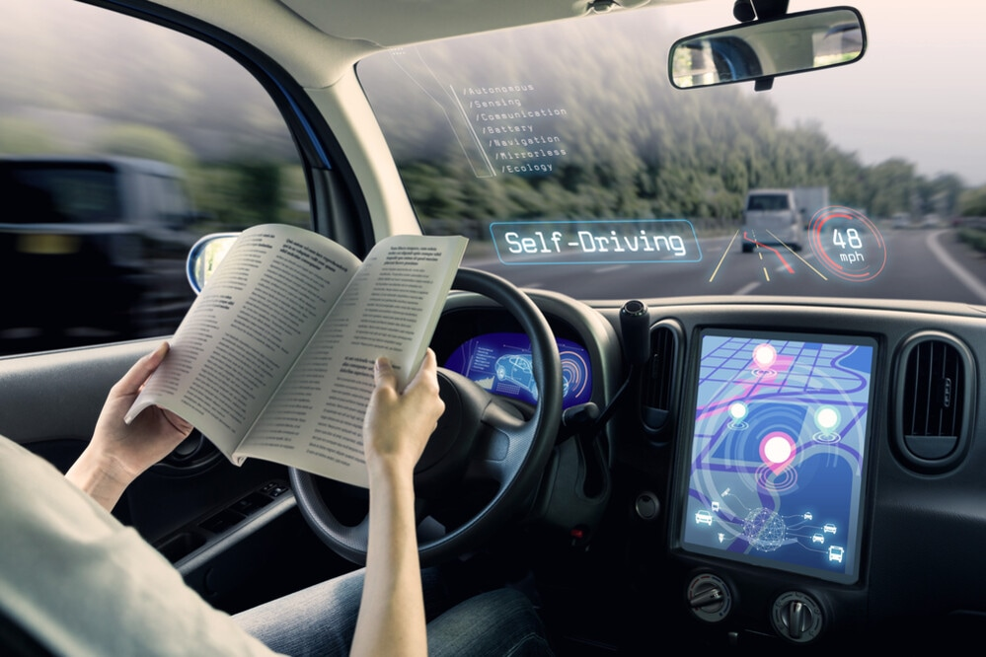
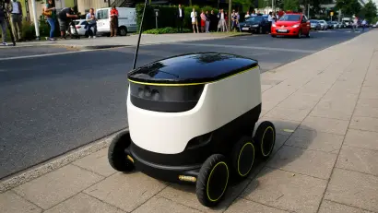
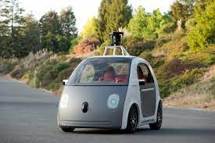
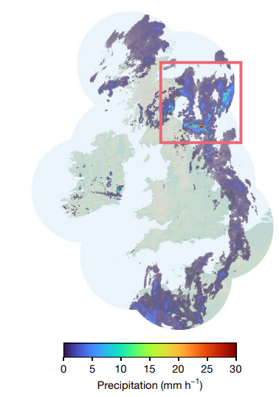
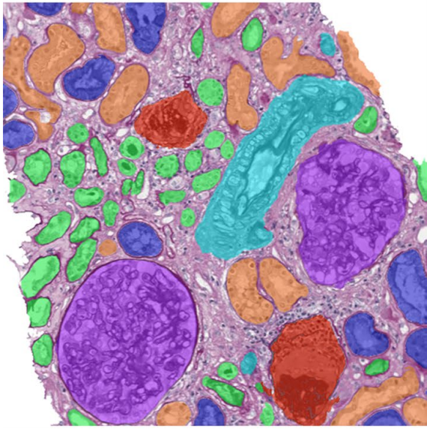
Visual Processing
Self-driving vehicles
Medical imaging
Weather forecasting
van der Laak et. al. Deep learning in histopathology: the path to the clinic. Nature 2021
Ravuri et al. Skilful precipitation nowcasting using deep generative models of radar. Nature 2021
Notes:
Medical imaging: https://www.nature.com/articles/s41591-021-01343-4
Weather forecasting: https://www.nature.com/articles/s41586-021-03854-z

Slide 8
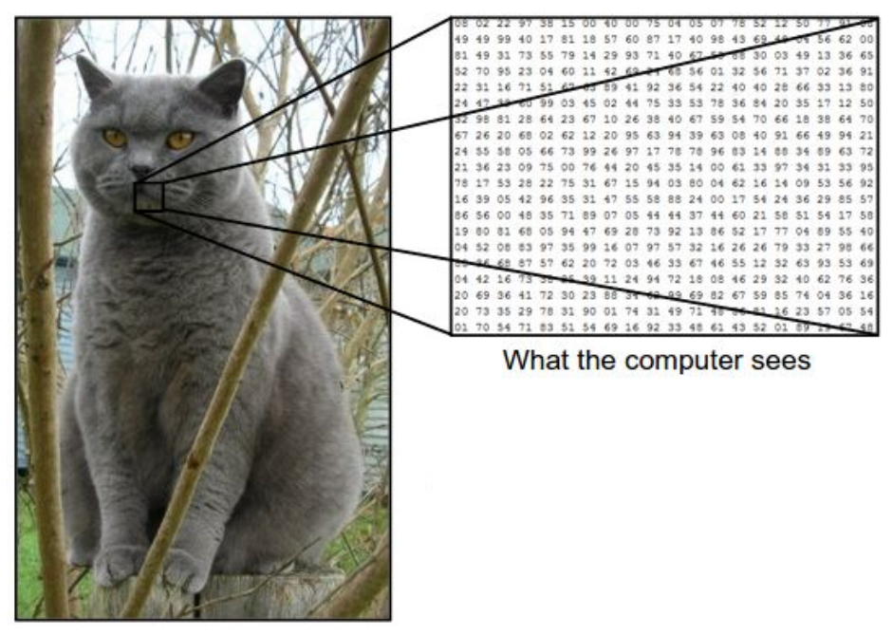
Process Images

Slide 9
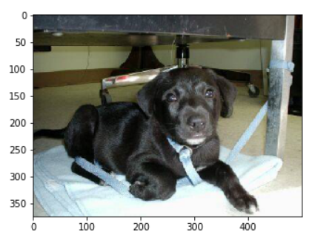
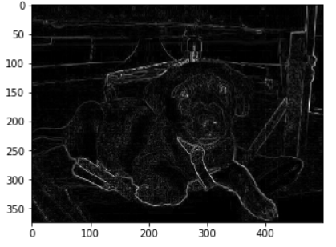
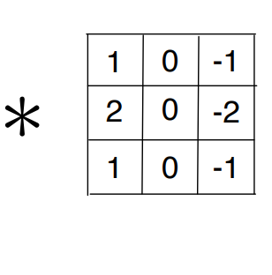
Convolution

Slide 10
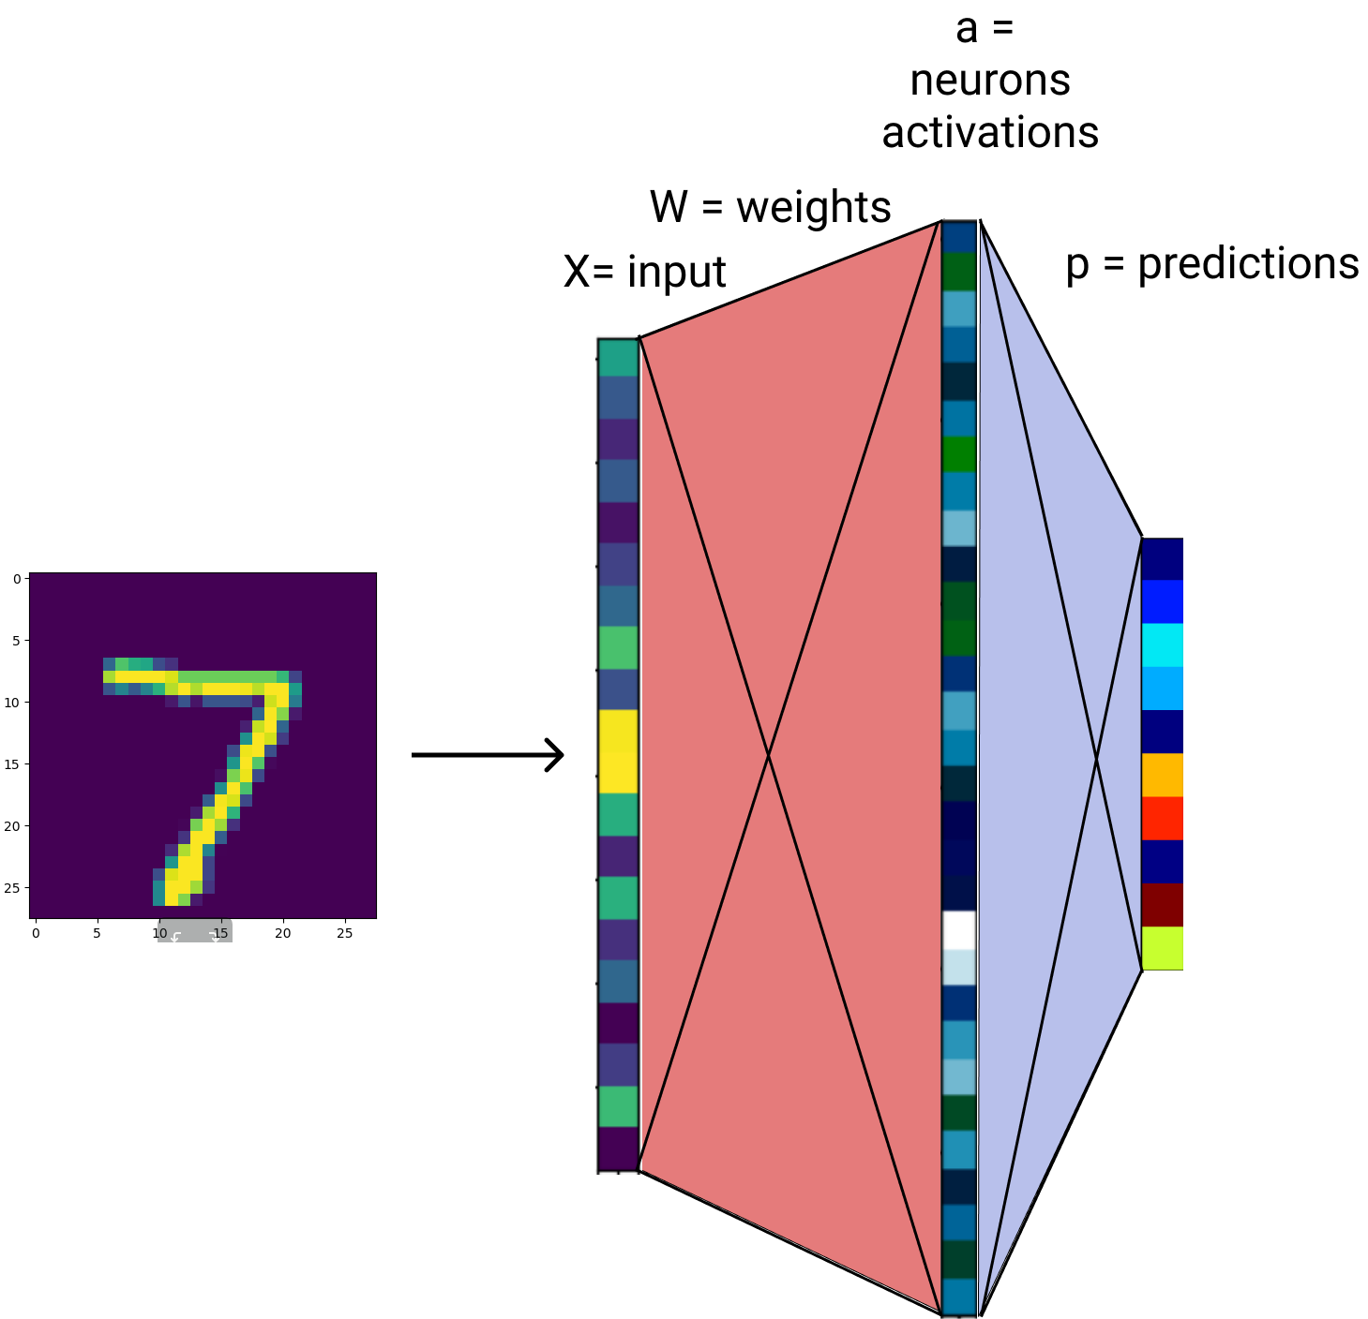
Process Images: How about fully connected networks?
Linearise image and treat it as a large vector
Process the image (vector) with fully connected network
Fully connected networks are universal approximators => they can represent anything

Slide 11
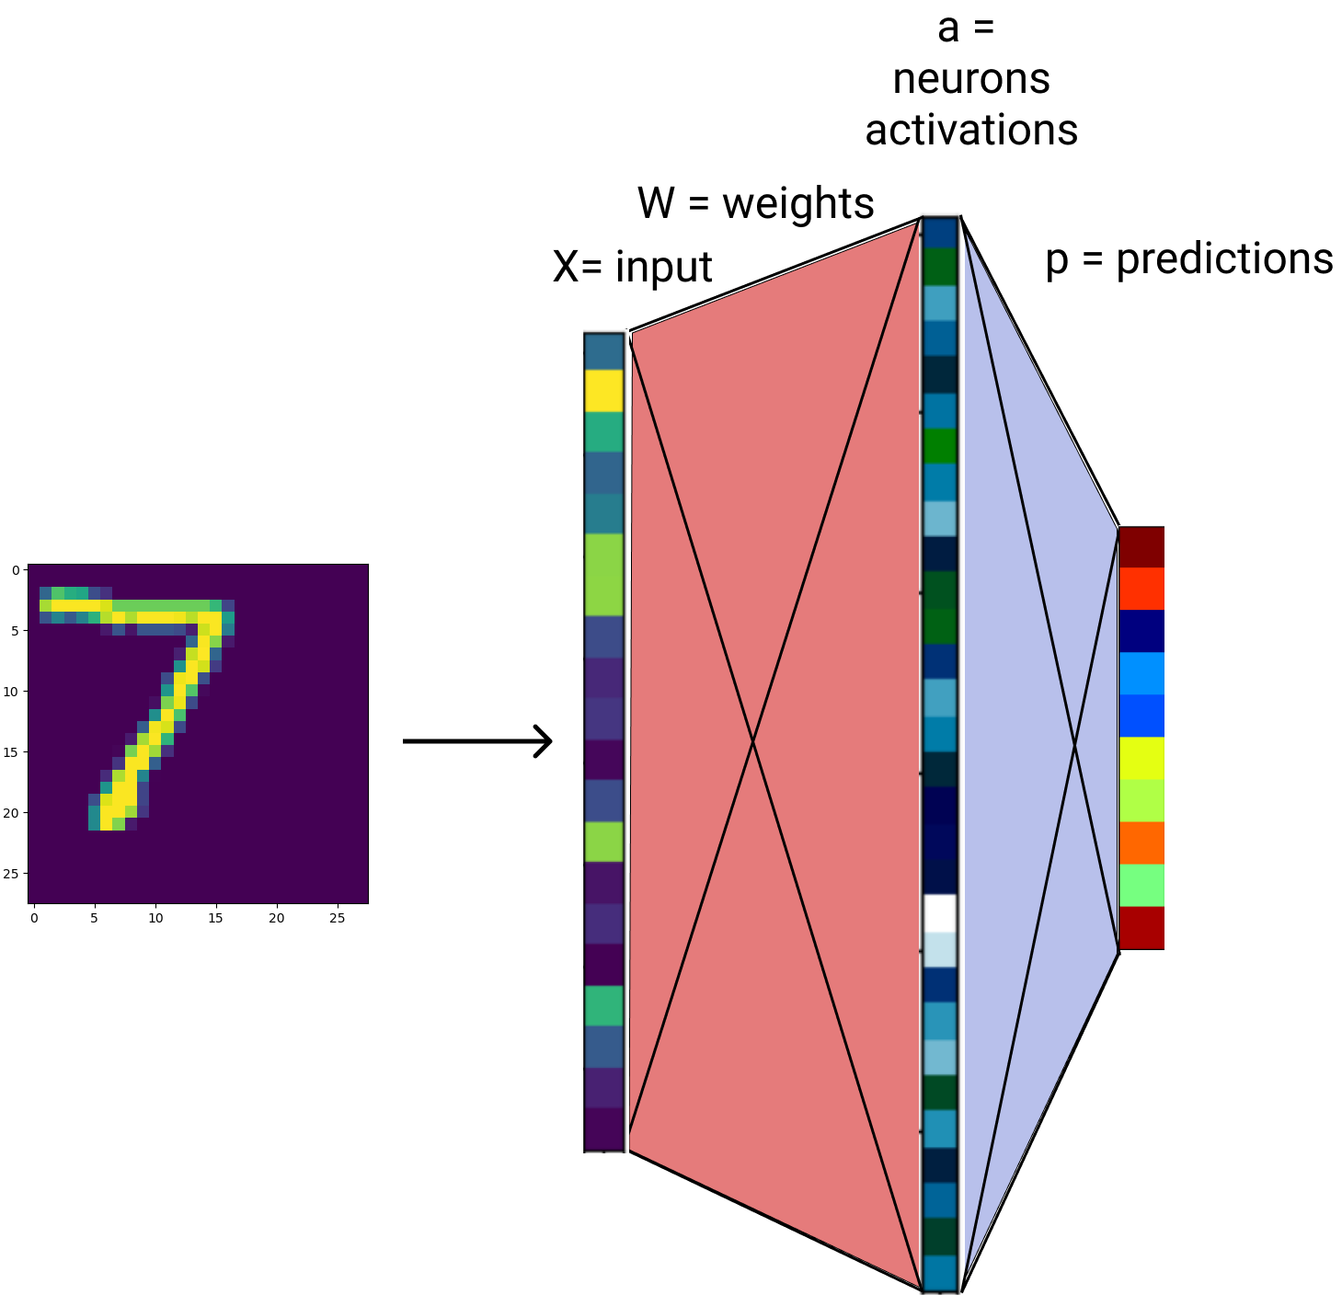
Process Images: Fully connected network
Linearise image and treat it as a large vector
Process the image (vector) with fully connected network
Fully connected networks are universal approximators => they can represent anything

Slide 12
Process Images: Fully connected network
Downsides:
Too MANY parameters
Different output for small translations
Every point is treated differently:
Network has to learn the same features for every location in the image
Inefficient:
In representation: it has to learn redundant features
In optimization: hard to train, requires a lot of training examples
Slow inference
Conclusion: inefficient

Slide 13
Process Images: Useful biases
Visual data has some useful biases:
Locality: for a pixel close neighbours are more important than distant ones
Stationarity: Same pattern has the same meaning regardless of position in the image
An architecture suited for processing visual data should incorporate these such inductive biases into its architecture.
Notes:
“Inductive bias describes the tendency for a system to prefer a certain set of generalizations over others that are equally consistent with the observed data.”
https://medium.com/flatiron-engineering/using-inductive-bias-as-a-guide-for-effective-machine-learning-prototyping-66e5468407a8
Battaglia et al. [2018]: Relational inductive biases, deep learning, and graph networks

Slide 14
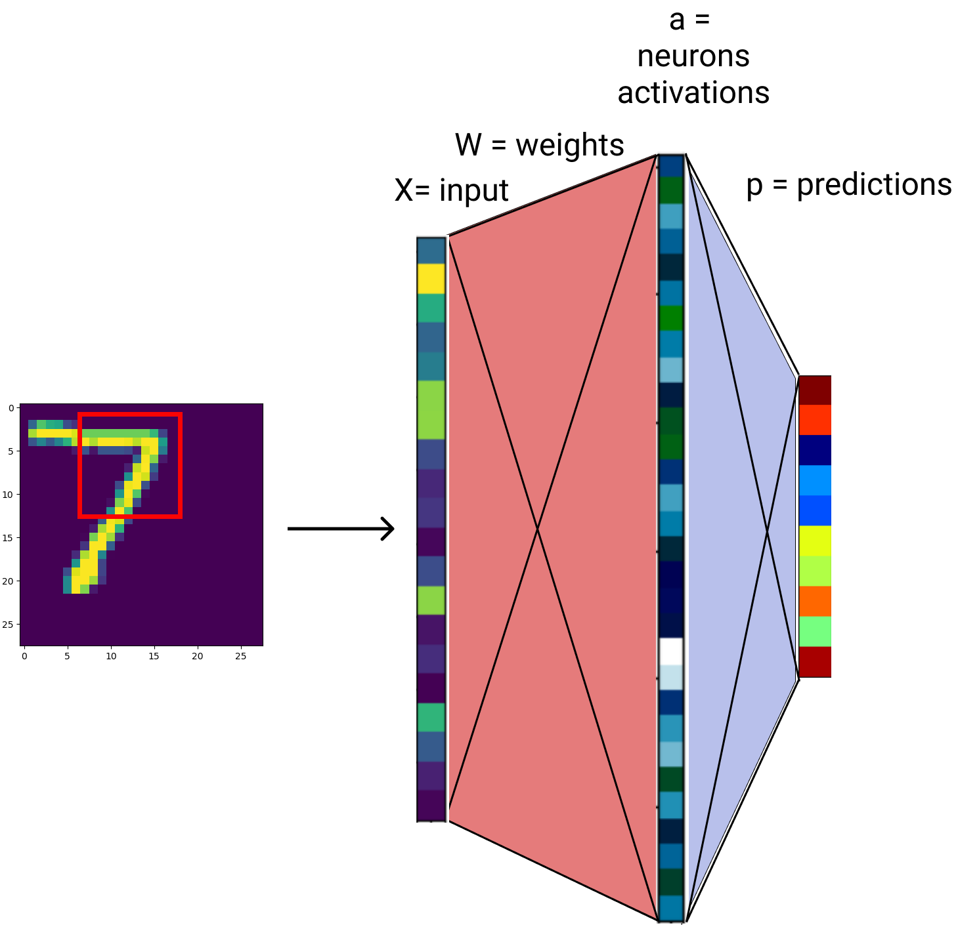
Process Images
To tackle these problems we will use an operation that is designed with the locality and stationarity properties in mind
Practically:
we restrict our operations to a small window
Apply a linear operation in that window (+ pointwise non-linearity)
Repeat the same process on every possible small window in the image

Slide 15
Process Images
Let's tackle locality problem
Restrict the input of the network to a small path

Slide 16
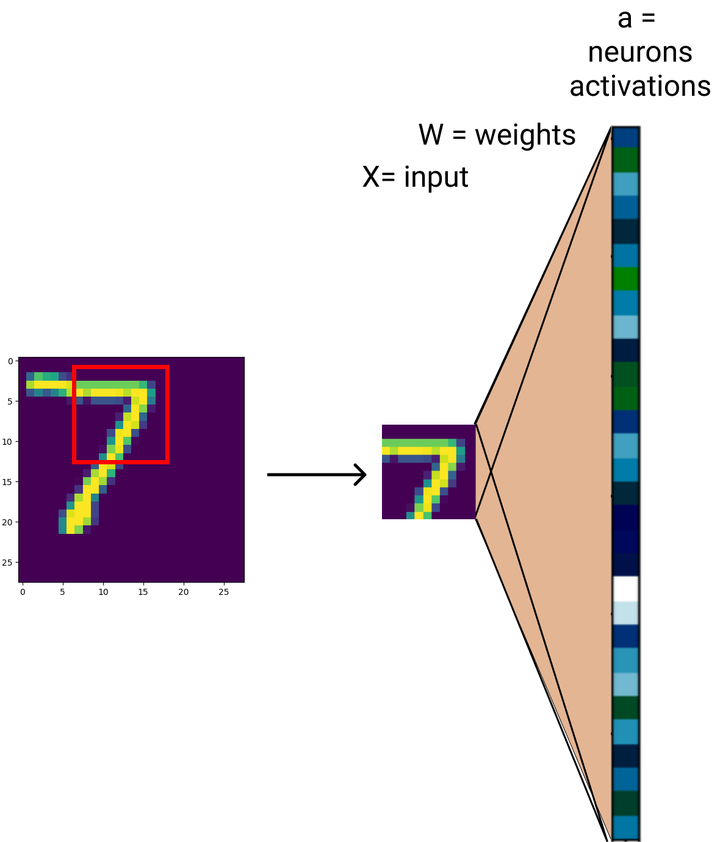
Process Images
Let's tackle locality problem
Let’s consider the first layer and restrict the input of the network to a small path

Slide 17
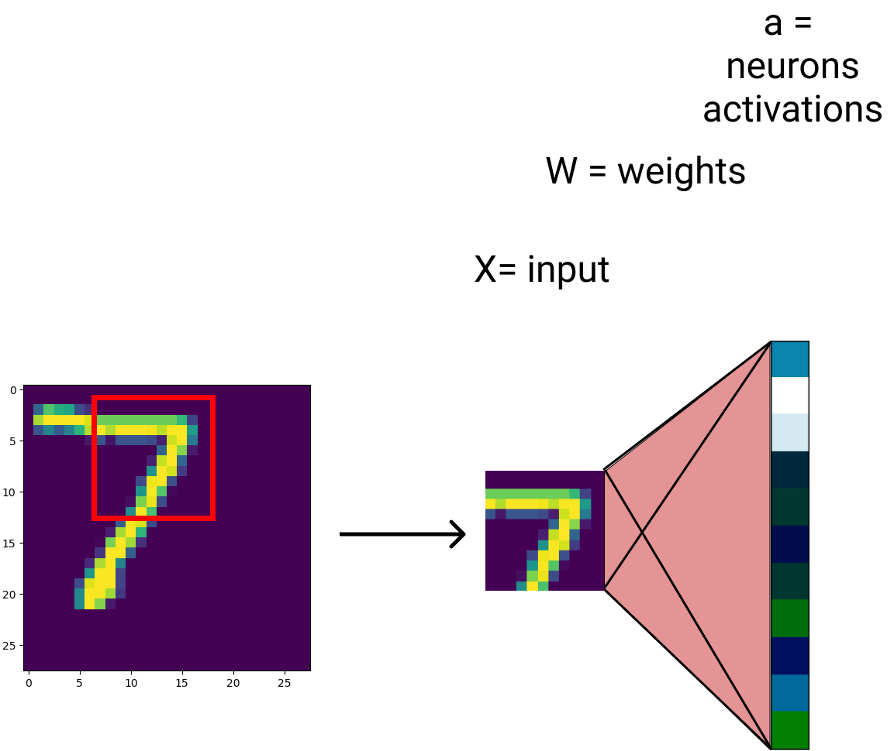
Process Images
Let's tackle locality problem
Restrict the input of the network to a small path
Small input: easier to model -> use fewer parameters

Slide 18
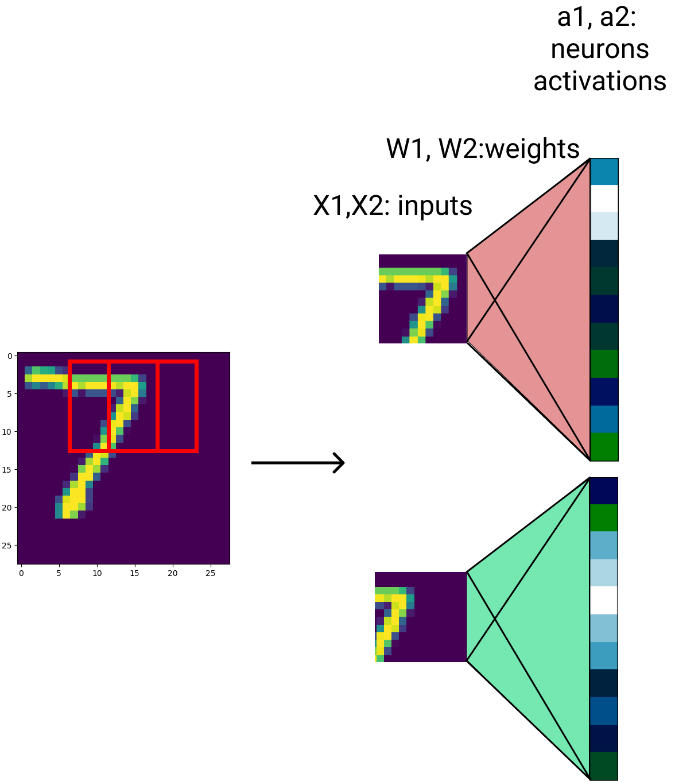
Process Images
Process in a sliding window approach multiple patches in the image

Slide 19
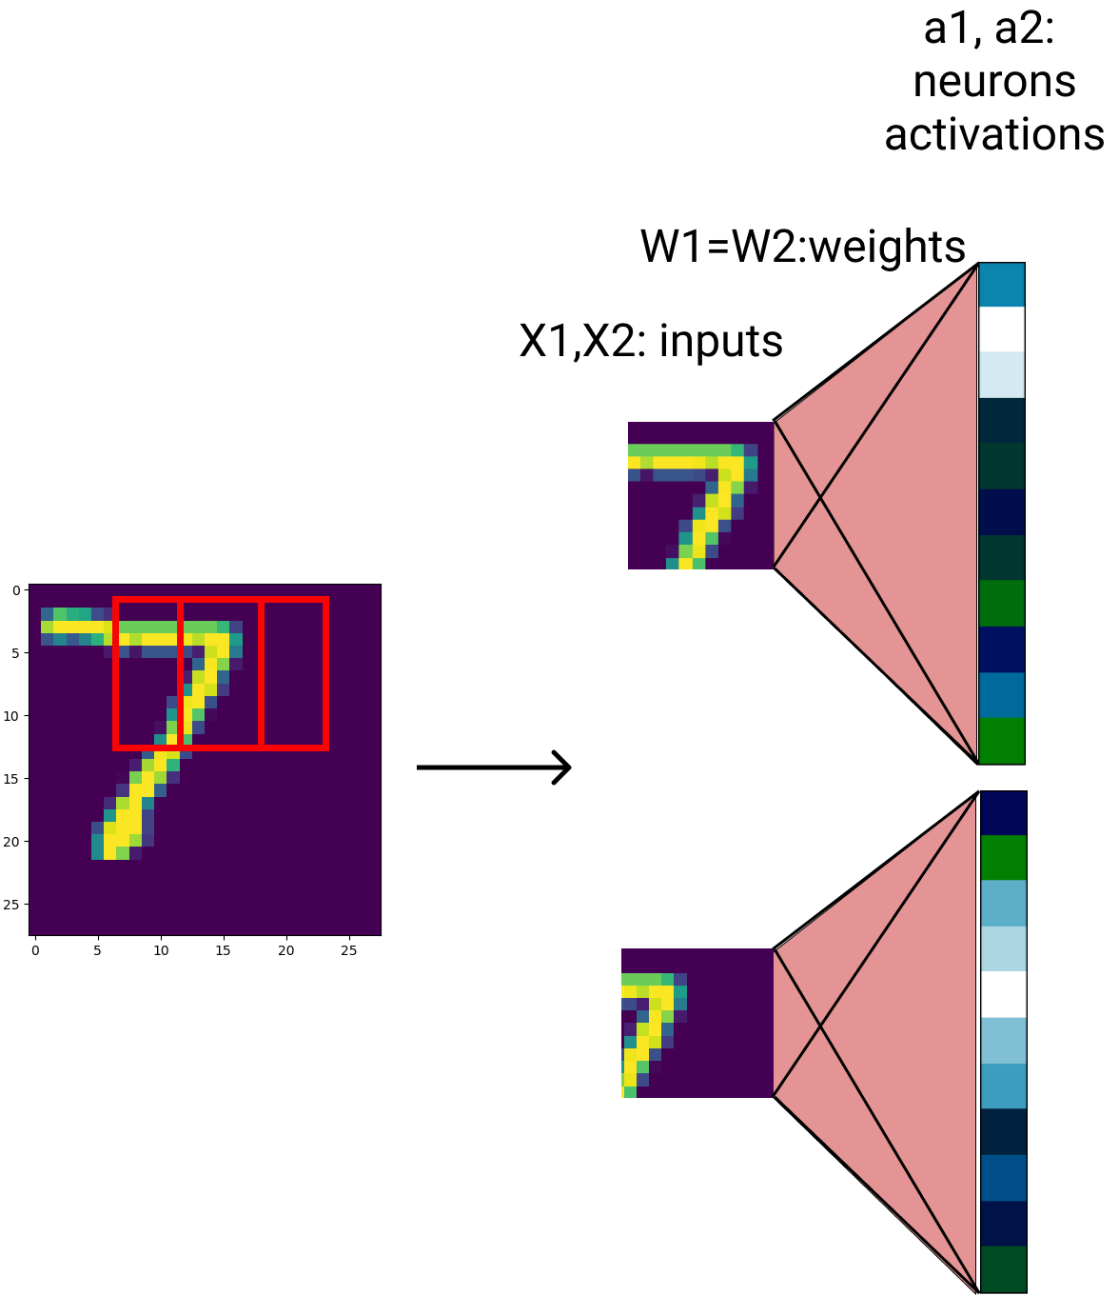
Process Images
Process in a sliding window approach multiple patches in the image
By the stationarity assumption: each location should be handled the same. Use the same function:
same weights

Slide 20
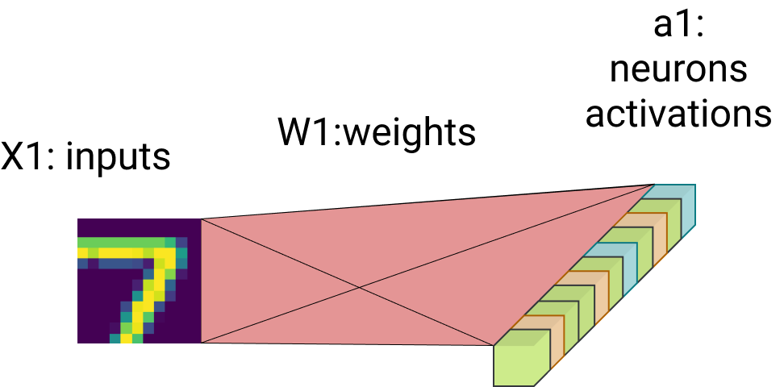
Process Images
Every patch has a corresponding output feature vector
x, a - vectors
W - matrix

Slide 21
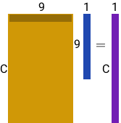
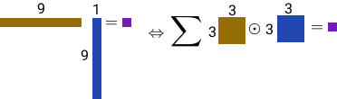
Process Images
We can rewrite the linear (+non-linear activation) in a different equivalent form.
Same mathematical operation - just different form
A single dot product between a line in the weights matrix W and the input x can be written as follows:
Parameters
Input

Slide 22
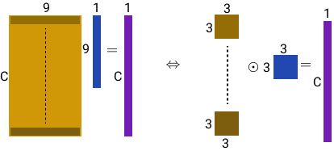
Process Images
Parameters
Input

Slide 23
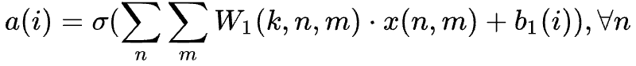
Process Images
Rewrite the linear operation Wx+b as elementwise multiplications and global sum
Parameters <- Kernels = Filters

Slide 24
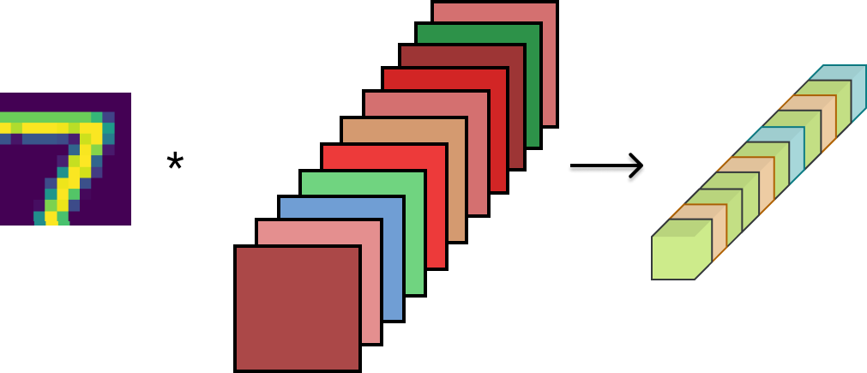
Process Images
Parameters / weights
Input
Rewrite the linear operation Wx+b as elementwise multiplications and global sum
Parameters <- Kernels = Filters
Activations
K
K

Slide 25
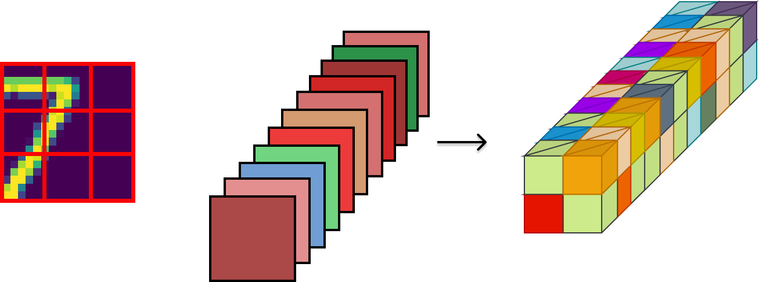

Convolutional Layer
Apply the same operation on every image patch
Output feature map
Input
Kernels (parameters)
Convolution operation

Slide 26
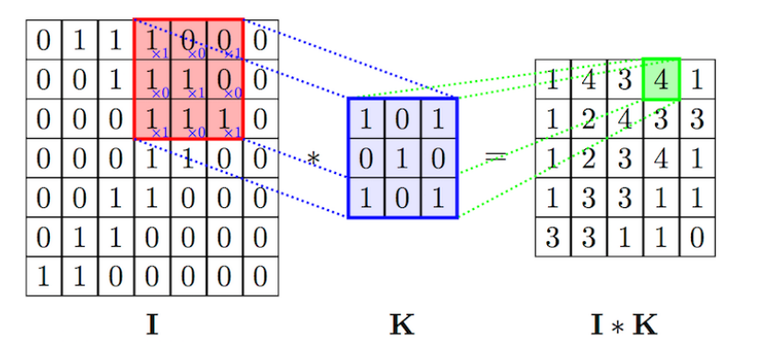
Convolution
Conv: Element-wise multiply the kernel and each patch and sum the result for every location
Can be interpreted as:
Search for a patch in the image that matches the kernel
Compute the matching for every location
Image from: https://anhvnn.wordpress.com/2018/02/01/deep-learning-computer-vision-and-convolutional-neural-networks/

Slide 27
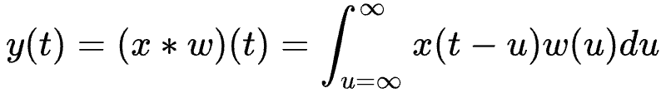
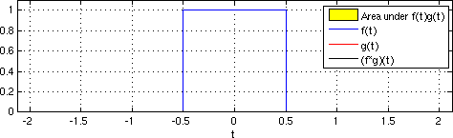
Convolution: continuous domain
For 1D continuous signals the convolution is defined as:
https://upload.wikimedia.org/wikipedia/commons/6/6e/Convolution_of_box_signal_with_itself.gif
Notes:
plus: la tabla aratat conv intre semnal si gaussian

Slide 28
Convolution

Slide 29
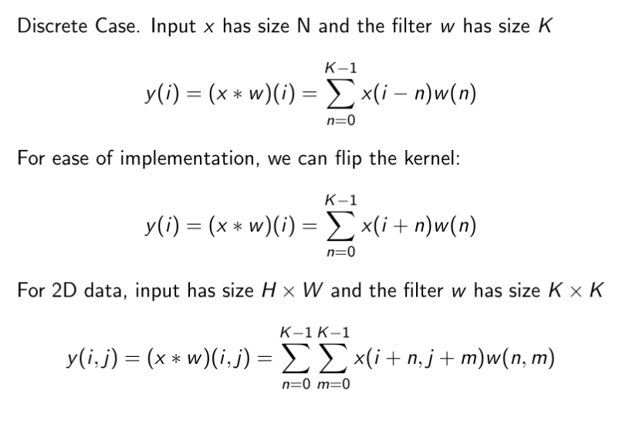

Convolution
Figure from https://github.com/vdumoulin/conv_arithmetic
Notes:
https://github.com/vdumoulin/conv_arithmetic

Slide 30
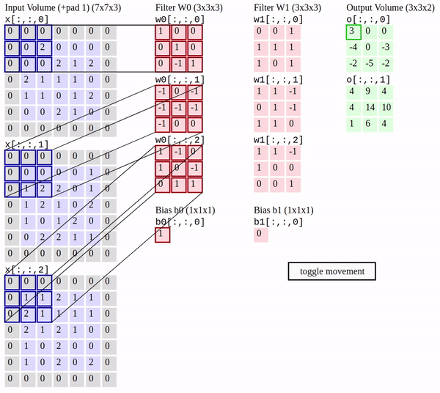
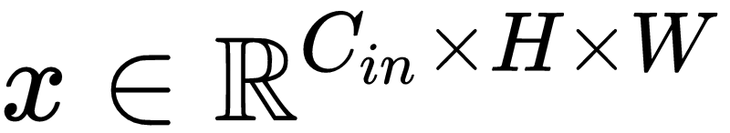
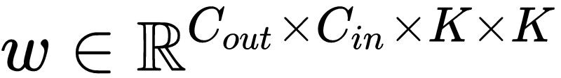
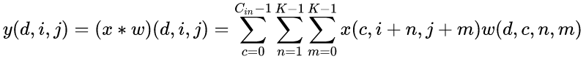
Convolutional Layer
The standard case for neural networks is having 2D inputs with multiple channels and kernels
d-th filter
Output channel
Input channel

Slide 31
Convolution
If the input has C channels
then each convolutional filter has C channels
Here we have 2 filters, each having size C x K x K = 3 x 3 x 3
In total:
Filter W has size 2 x C x K x K
(we sometimes say that we have 2 filters of size K x K with C channels)
Bias b has size 2
Image from: http://cs231n.github.io/convolutional-networks/

Slide 32
Convolutional Layer
Convolutional operation includes:
Input x (images)
Learnable Parameters named filters or kernels or weights
output feature map
Output feature map
Input
Kernels
Convolution operation

Slide 33

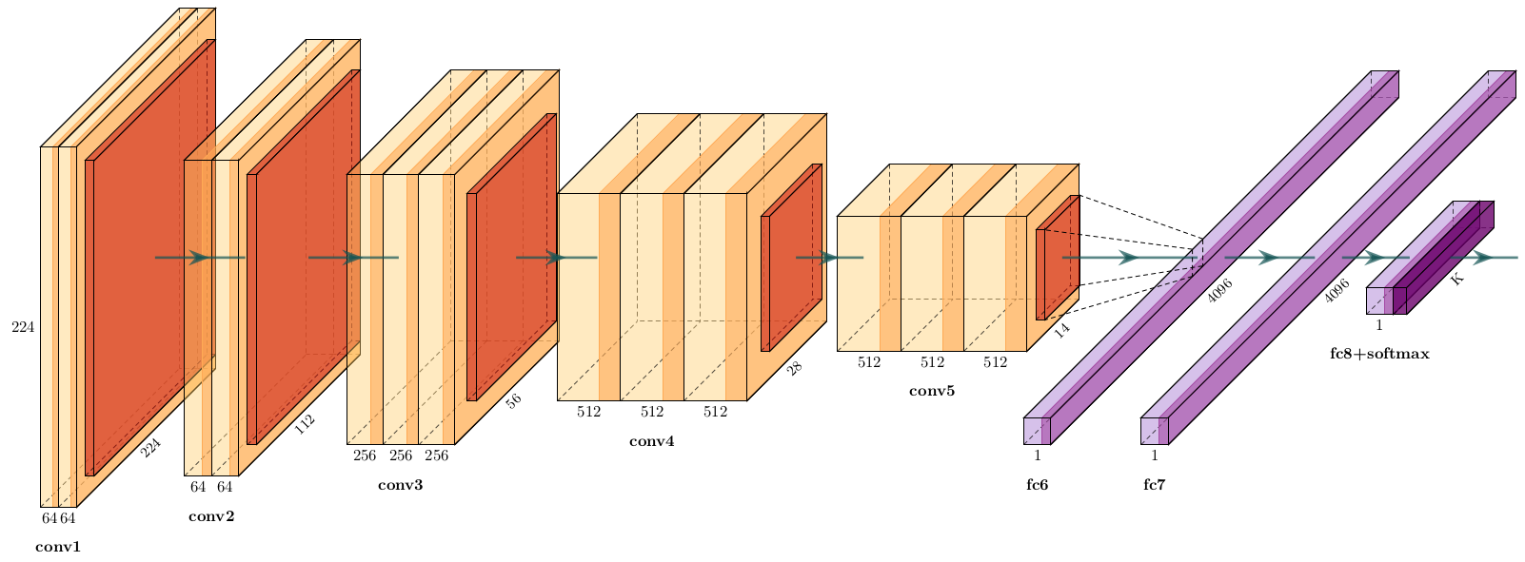
Convolutional Networks
A convolutional network is formed by stacking multiple convolutional layers, with non-linear activations in between. At the end, fully connected layers could be used.
Going from the first layers to the last, the features obtained by the network have different meanings. In the first layers they represent low-level features such as edges, textures, while in the upper layers the features could represent entities such as parts or whole objects
Edges -> textures -> entities

Slide 34
Convolutional Networks
A convolutional network is formed by stacking multiple convolutional layers, with non-linear activations in between. At the end, fully connected layers could be used.
Going from the first layers to the last, the features obtained by the network have different meanings. In the first layers they represent low-level features such as edges, textures, while in the upper layers the features could represent entities such as parts or whole objects
Edges -> textures -> entities

Slide 35
Convolutional Networks
A convolutional network is formed by stacking multiple convolutional layers, with non-linear activations in between. At the end, fully connected layers could be used.
Going from the first layers to the last, the features obtained by the network have different meanings. In the first layers they represent low-level features such as edges, textures, while in the upper layers the features could represent entities such as parts or whole objects
Edges -> textures -> entities

Slide 36
Recap - Convolutional operation
It is efficient because it takes advantage of properties of the data
Locality and stationarity
Appropriate for cases where the data has these properties:
Images, videos
Audio
Sequence of words
Any problem where spatial structure plays a key role
Keywords:
Learnable parameters: Kernel = filter + bias

Slide 37
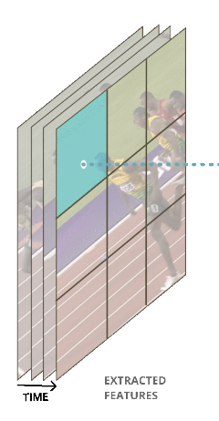
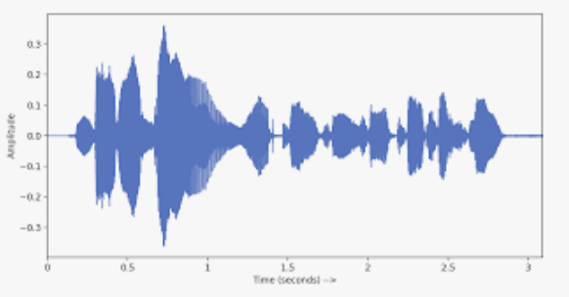
Convolutional operation in different modalities
The the filter should have “spatial” dimensions for the dimensions of the data that exhibit locality
Images: filter shape [height x height]
Videos: filter shape [time x height x height]
Audio: filter shape [time]
Sequence of words: filter shape [time]
H
W
T
H
W
T

Slide 38
Convolution
We will see how convolutions are applied in standard convolutional networks.
Introduce some key concepts
Figure from https://github.com/vdumoulin/conv_arithmetic
Notes:
https://github.com/vdumoulin/conv_arithmetic

Slide 39
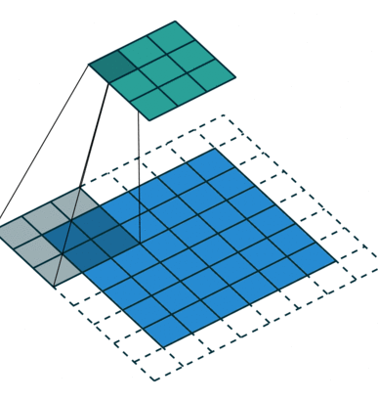
Convolution: Stride
Skip computations with a stride
Stride k: move each patch by k pixels
Reduces the resolution of the output
Figure from https://github.com/vdumoulin/conv_arithmetic

Slide 40
Convolution: Padding
Lose information at margins
The output features maps are smaller than the input
Solutions:
Apply padding to the input
Process margins separately with different kernels
Figure from https://github.com/vdumoulin/conv_arithmetic
Notes:
https://github.com/vdumoulin/conv_arithmetic

Slide 41

Convolution: Padding
Use padding half the filter size, to keep the output the same size as the input
Different kinds of padding:
Zero, reflexive
Figure from https://github.com/vdumoulin/conv_arithmetic
Notes:
https://github.com/vdumoulin/conv_arithmetic

Slide 42
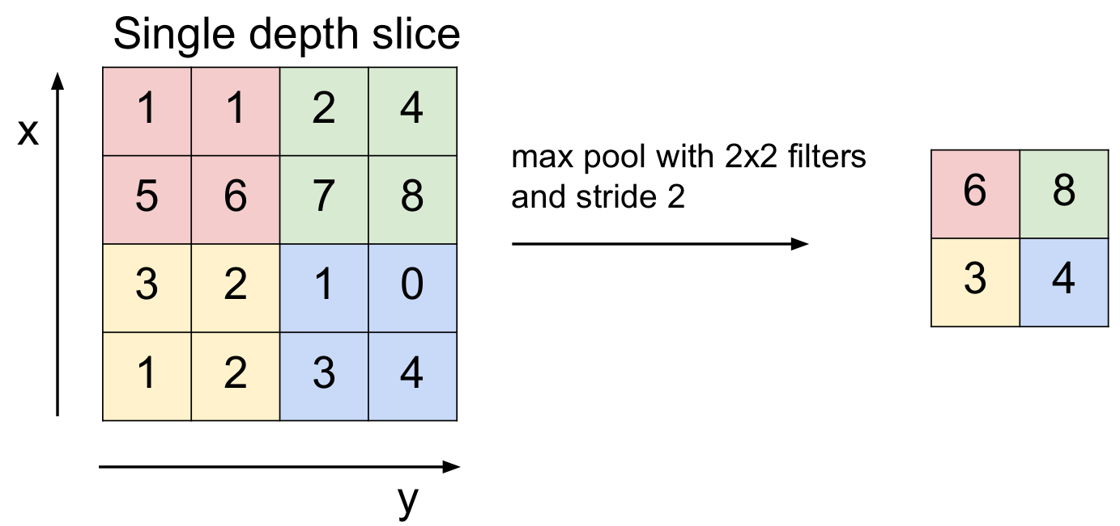
Pooling
From every patch output one value
Reduce output resolution:
Output is invariant to small local translations
Make the computation lighter
Pooling types: max, average
Figure from: CS231n Stanford Course

Slide 43
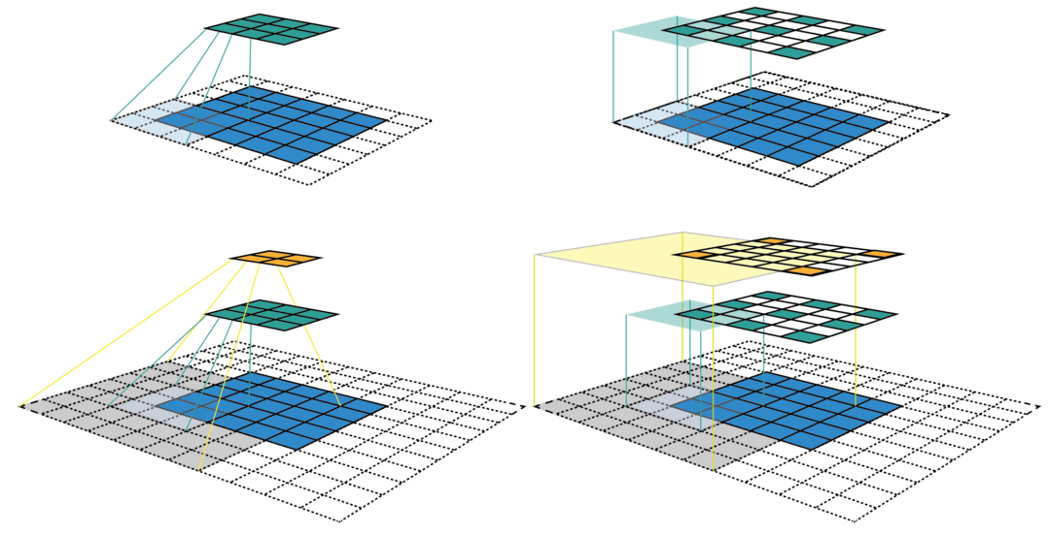
Receptive field
Receptive field of a point in a feature map:
Region of the image that influences that point
Receptive field grows:
linear with the number of layers with stride one
multiplicatively by using layers with stride > 1
linear with size of filters
Figure from: https://medium.com/mlreview/a-guide-to-receptive-field-arithmetic-for-convolutional-neural-networks-e0f514068807

Slide 44
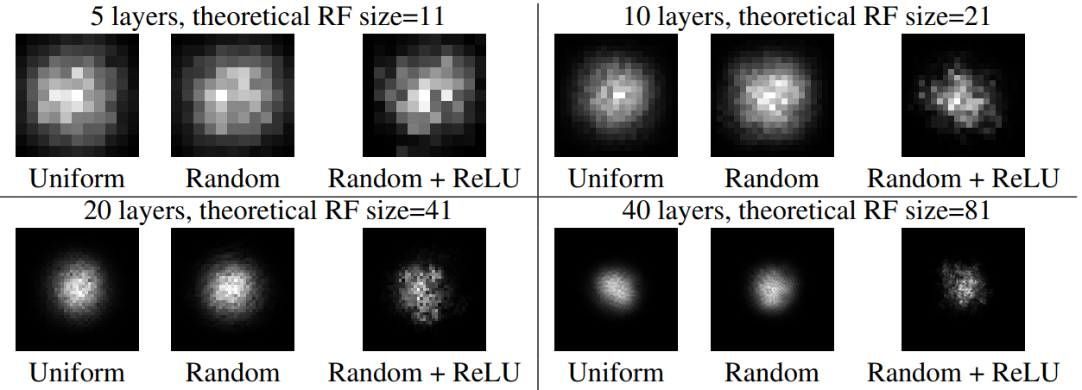
Effective Receptive field
Effective Receptive field of a point in a feature map:
Region of the image that influences that point in a non-negligible way
effective receptive field only takes up a fraction of the full theoretical receptive field
distribution of effective receptive field: asymptotically Gaussian
Effective Receptive Field
Figure from: Luo et. al: Understanding the effective receptive field in deep convolutional neural networks

Slide 45
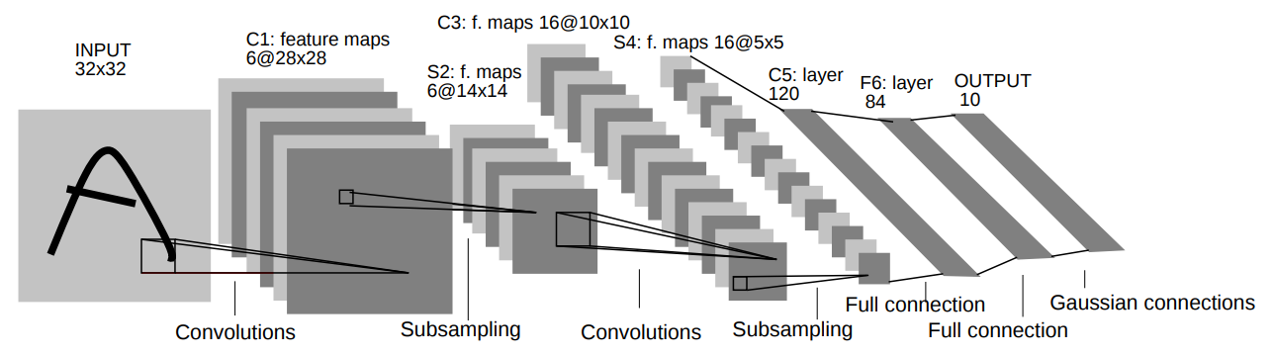
Convolutional Networks in 1998: LeNet-5
LeCun et al. [1998]: Gradient-based learning applied to document recognition

Slide 46
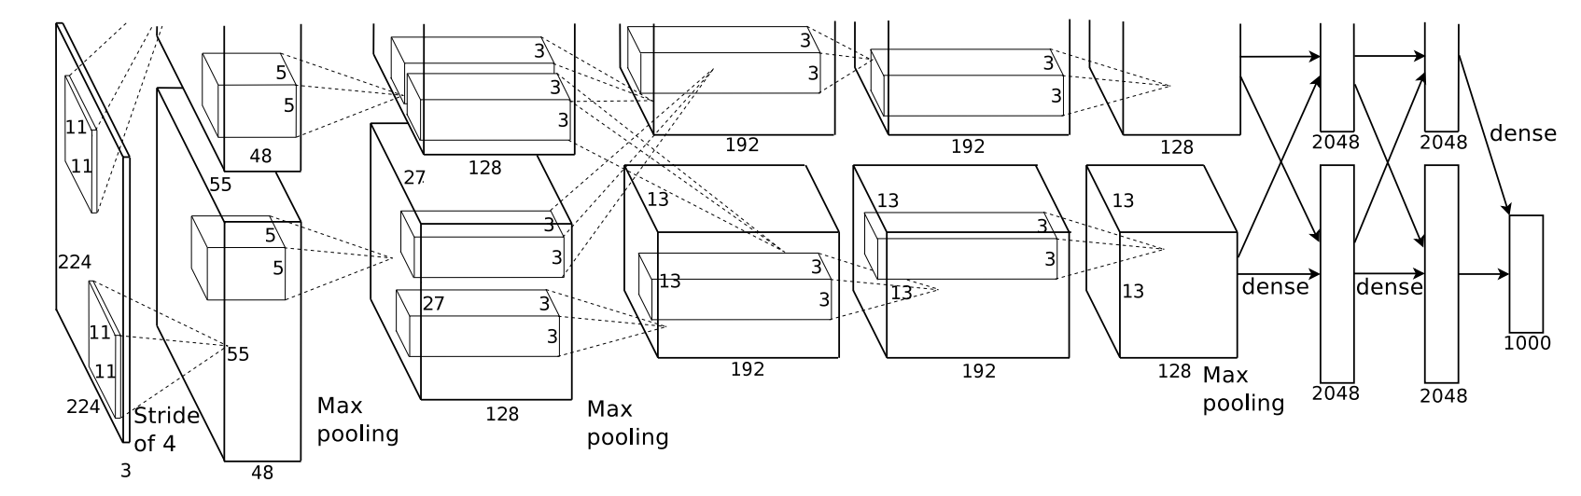
Convolutional Networks in 2012: AlexNet - DL revolution
fast conv nets implemented on GPU started to obtain superior results: DanNet [2011] - AlexNet [2012]
By winning the 2012 ImageNet competition AlexNet is considered to have triggered a revolution in ML, starting the current wave of Deep Learning methods
Krizhevsky et al. [2012]: Imagenet classification with deep convolutional neural networks
Dan Cireșan, U Meier, J Schmidhuber [2011]: Multi-column Deep Neural Networks for Image Classification

Slide 47
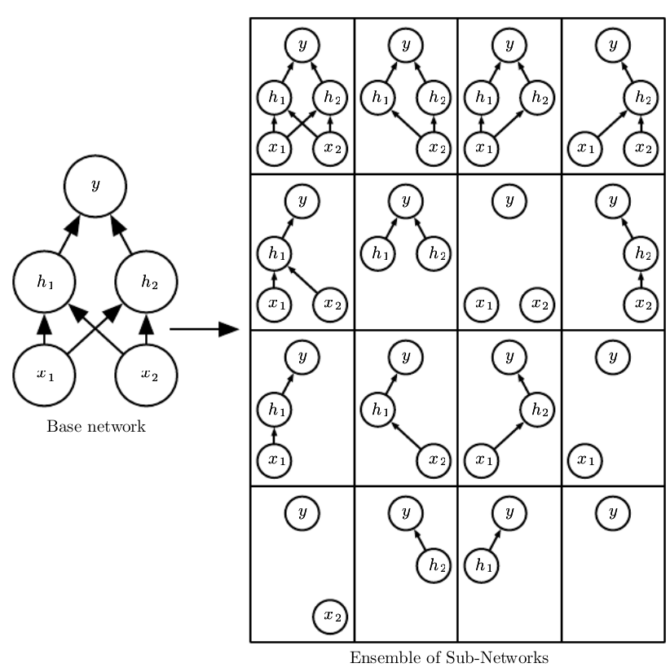
Dropout
At each step in the optimisation algorithm make 50% of neuron activations zero
At testing time (inference) use all the output but scaled with 0.5
Reduces overfitting by regularise the network
Make each neuron not relying on fixed features
=> more robust model
Create implicit ensemble of subnetworks
Image from: I. Goodfellow et. al: Deep Learning book

Slide 48
Regularization
Any strategy used to reduce its generalization error but not the training error
Constraints and penalties designed to encode prior knowledge or to impose preference towards simpler models in order to promote generalization
General Regularizations:
Weight decay: L2 or L1 penalties of parameters norm
Dropout
More data / Data augmentation
Adding noise: to input / activations / weights / labels
Early Stopping
Implicit Convolutional Regularizations:
Weight sharing across locations
Local / gaussian effective receptive fields

Slide 49
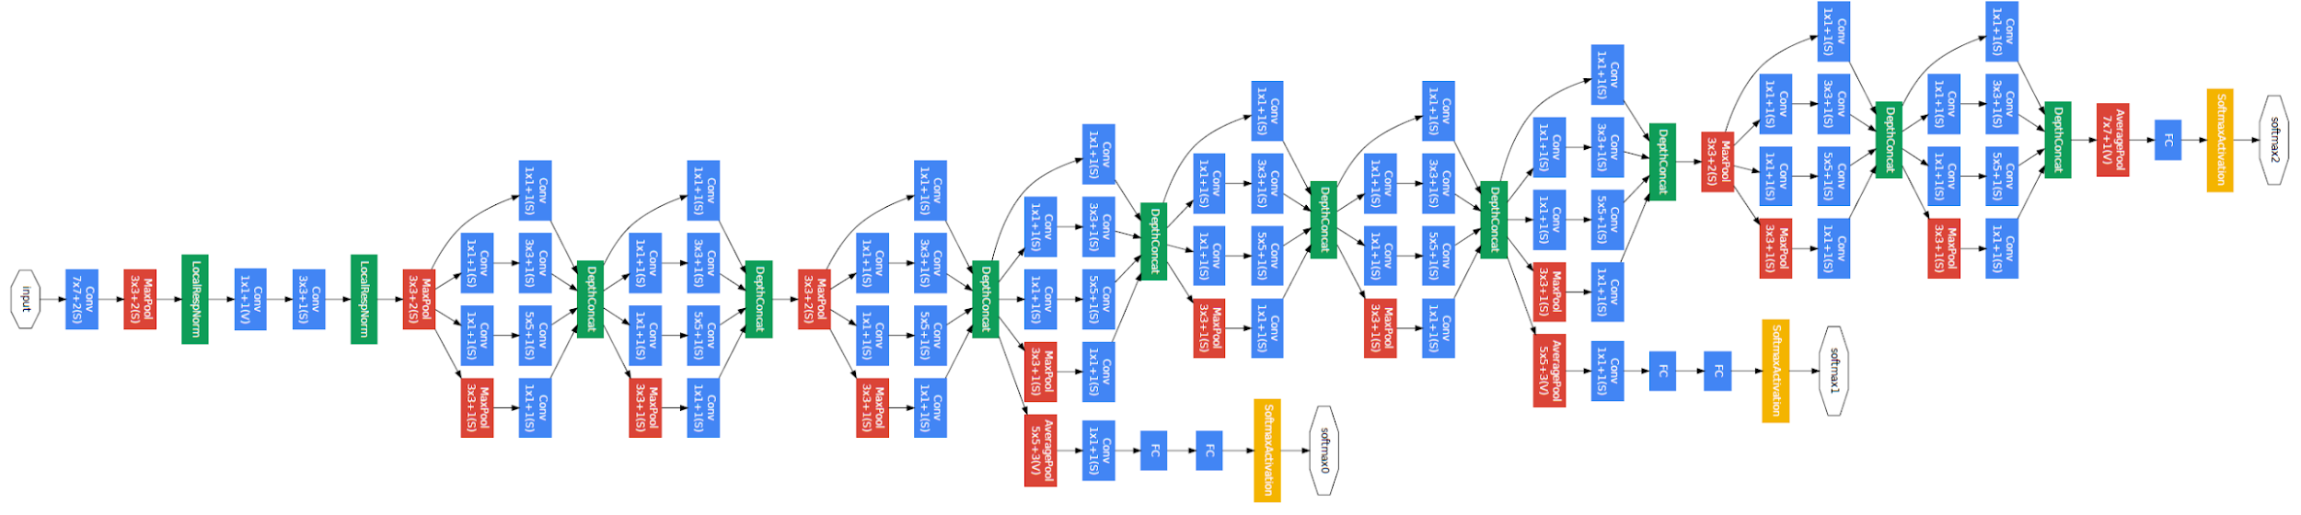
Convolutional Networks in 2014: GoogleNet - Inception V1
Core principles:
efficient utilization of the computing resources
multi-scale processing inside the network
Results
ImageNet ILSVRC14 winner (6.7% top 5 error)
12x less parameters than AlexNet while significantly more accurate
Szegedy et al. [2015]: Going deeper with convolutions

Slide 50

Inception Module
Use 1x1 convolutions to reduce the dimensions
1x1 convolutions project every pixel information into a lower dimensional space
I : 512 x 28 x 28 -> O: 64 x 28 x 28
The resulting embedding act as a compressed information

Slide 51

Final Layers
After the last inception module simply use average pooling
Final linear layer + softmax
By replacing fully connected with average pooling:
Removes many parameters from the last fully connected layers
improved the top-1 accuracy by about 0.6%
For comparison: a previous convnet (VGG16) has 73% of its parameters (103M / 138M) just in the first fully connected layer after the convolutional part

Slide 52

Auxiliary Losses
Use auxiliary losses in intermediate layers
Final loss: weighted sum of all losses
Goals:
Combat vanishing gradients
More stable learning
Improve convergence
Act as regularizers

Slide 53

Convolutional Networks in 2015: Inception - v2
Use Batch Norm
Ioffe and Szegedy [2015]: Batch normalization: Accelerating deep network training by reducing internal covariate shift.

Slide 54

Batch Norm
Different kinds of normalisation
Batch Norm for Vision - ConvNets
Layer Norm for NLP & CV - recurrent Nets, Transformers, GNNs
Spectral Norm for RL
Ba et.al. Layer Normalization. 2016
Gogianu et. al: Spectral Normalisation for Deep Reinforcement Learning: An Optimisation Perspective. ICML 2021

Slide 55


Convolutional Networks in 2016: Inception - v3
Factorise the convolutions
Replace N x N kernels with N x 1 and 1 x N kernels
Reduces computations
Acts as a regularization
Szegedy et al. [2016]: Rethinking the inception architecture for computer vision

Slide 56






Kernel Factorisation: SVD motivation

Slide 57
Kernel Factorisation: SVD motivation
An N x N matrix is decomposed in maximum N vector outer products
By using fewer we arrive at a low rank matrix:
Fewer computations
Better regularisation
In practice, same representation power

Slide 58

Convolutional Networks in 2016: ResNet
Core principles:
Train deeper models
Easily optimise by allowing direct paths between lower and upper levels
He et al. [2016]: Deep residual learning for image recognition

Slide 59

Convolutional Networks in 2016: ResNet
Deep ‘plain’ networks obtain worse results by increasing the number of layers
Cause:

Slide 60
Convolutional Networks in 2016: ResNet
Deep ‘plain’ networks obtain worse results by increasing the number of layers
Cause: Overfit? NO
Optimization problem

Slide 61

Convolutional Networks in 2016: ResNet
Add skip connections between between layers
The representation power of the network remains the same
The network can easily learn identity mapping
The optimisation is easier

Slide 62

Convolutional Networks in 2016: ResNet
Without BN
With BN
Effect of the residual connections
Deeper models can be trained and can improve shallower models

Slide 63



Convolutional Networks in 2018: Mobilenetv2
Use Depthwise separable convolutions
Replace one 3D convolutions with kernel of size [H x W x num_input_channels] apply 2 convolutions:
2D convolution applied independently on each input channel
using kernels of size [H x W]
1D convolution applied independently at each location
Using kernels of size [1x1xnum_input_channels]
Normal conv
Depthwise separable conv
Sandler et al. [2018]: Mobilenetv2: Inverted residuals and linear bottlenecks

Slide 64
Convolutional Networks in 2018: Mobilenetv2
Advantages of Depthwise separable convolutions:
More computational efficient: 2D + 1D convolution requires less computation than 3D convolution
More parameter efficient: less number of parameters
Good inductive bias in learning: sharing the same 2D filters over channel gives a good inductive bias (this might not hold always)
Sandler et al. [2018]: Mobilenetv2: Inverted residuals and linear bottlenecks

Slide 65

Convolutional Networks in 2019: Efficientnet
Proposes a good way to scale the dimensions of the components to have the most improvements with as few computations as possible
Tan et al. [2019]: Efficientnet: Rethinking model scaling for convolutional neural networks

Slide 66


Convolutional Networks Analysis
Canziani et al. [2016]: An analysis of deep neural network models for practical applications.
Liu et. al. [2022]: A ConvNet for the 2020s + Lucas Beyer correction https://twitter.com/giffmana/status/1481054929573888005

Slide 67

Future of Convolutions in Visual Processing
Newer methods like Transformers and MLP-Mixers can bring benefits like long-range connection
Are still based on the same principles of
Locality
Stationarity
Tolstikhin et al. [2021]: MLP-Mixer: An all-MLP Architecture for Vision

Slide 68

Recap:
Basic components remained stable
In the last 12 years we added
Deeper and bigger architectures trained by SGD on GPUs
Better regularisation: dropout, batch norm
Better optimisation: skip connection, adam
More efficient use of params: factorisations
Deep Neural Nets: 33 years ago and 33 years from now https://karpathy.github.io/2022/03/14/lecun1989/

Slide 69
Inductive biases of CNNs
Convolutional networks are suited for visual tasks because they have inductive biases implicit in their architecture, that makes representing and learning the visual data more easily
Locality
Translation equivariance - (same output regardless of position)
For visual data, CNN are more efficient than fully connected layer
But how much training is really necessary?
In some cases, tasks could be solved by learning just a small fraction of the parameters (although this is not the that usual..)

Slide 70


Training BatchNorm and Only BatchNorm
Batch Norm
Train only the scale and shift (gamma, beta) parameters of BN and keep randomly initialized all the other parameters of the network
‘Surprisingly’ good results
Frankle et al. [2020] Training BatchNorm and Only BatchNorm: On the Expressive Power of Random Features in CNNs
Notes:
Frankleet al. [2020] Training BatchNorm and Only BatchNorm: On the Expressive Power of Random Features in CNNs

Slide 71


Restore Images without training
Generate an image starting from random noise vector
Optimize a convolutional network to generate an image close to the input
Without training on any other images, just optimize on the single input
Takes advantage of the inductive biases of the model to produce probable images
Ulyanov et al. [2018] Deep Image Prior

Slide 72
Thank you!
(Next: NN applications for Computer Vision)

Slide 73
Other Resources
http://cs231n.github.io/convolutional-networks/
http://cs231n.github.io/transfer-learning/

Slide 74
References
A. Canziani, A. Paszke, and E. Culurciello. An analysis of deep neural network models for practical applications. arXiv preprint arXiv:1605.07678, 2016.
Frankle, J., Schwab, D.J. and Morcos, A.S., 2020. Training BatchNorm and Only BatchNorm: On the Expressive Power of Random Features in CNNs. arXiv preprint arXiv:2003.00152.
I. Goodfellow, Y. Bengio, and A. Courville. Deep Learning. MIT Press, 2016. http://www.deeplearningbook.org.
K. He, X. Zhang, S. Ren, and J. Sun. Deep residual learning for image recognition. In Proceedings of the IEEE conference on computer vision and pattern recognition, pages 770–778, 2016.
S. Ioffe and C. Szegedy. Batch normalization: Accelerating deep network training by reducing internal covariate shift. In Proceedings of the 32Nd International Conference on International Conference on Machine Learning - Volume 37,ICML’15, pages 448–456. JMLR.org, 2015.
A. Krizhevsky, I. Sutskever, and G. E. Hinton. Imagenet classification with deep convolutional neural networks. In Advances in neural information processing systems, pages 1097–1105, 2012.
Y. LeCun, L. Bottou, Y. Bengio, P. Haffner, et al. Gradient-based learning applied to document recognition. Proceedings of the IEEE, 86(11):2278–2324, 1998.

Slide 75
References
W. Luo, Y. Li, R. Urtasun, and R. Zemel. Understanding the effective receptive field in deep convolutional neural networks. In Advances in neural information processing systems
K. Simonyan and A. Zisserman. Very deep convolutional networks for large-scale image recognition. arXiv preprint arXiv:1409.1556, 2014.
C. Szegedy, W. Liu, Y. Jia, P. Sermanet, S. Reed, D. Anguelov, D. Erhan, V. Vanhoucke, and A. Rabinovich. Going deeper with convolutions. In Proceedings of the IEEE conference on computer vision and pattern recognition, pages 1–9, 2015.
C. Szegedy, V. Vanhoucke, S. Ioffe, J. Shlens, and Z. Wojna. Rethinking the inception architecture for computer vision. In Proceedings of the IEEE Conference on Computer Vision and Pattern Recognition, pages 2818–2826, 2016.
Ulyanov, D., Vedaldi, A. and Lempitsky, V., 2018. Deep image prior. In Proceedings of the IEEE Conference on Computer Vision and Pattern Recognition (pp. 9446-9454).

